Slide 1
Final Presentation Multivariate Analysis - 2017 Fall
The effect of exchange policies
on liquidity of cryptocurrency markets
Rocku Oh
Ulsan National Institute of Science and Technology
2017.12.07
Financial Markets and Trading Laboratory
20175404 Rocku Oh

Slide 2
Introduction
Bitcoin has much attention nowadays by investors in recent years
Cryptocurrency is a decentralized electronic currency system
The technology is based on peer-to-peer networks and cryptographic protocols
Bitcoin is not managed by any governments or bank
The characteristics have posed great challenges and opportunities for policy makers, economists, and researchers

Slide 3
Problem statement
The previous research
focused was initially dominated by studies on the safety, ethical and legal aspects of Bitcoin
The exchanges(brokers) become a key issue on trading of cryptocurrency
However there was a little attention on exchanges where the cryptocurrencies are traded
Exchange has their own trading policies
Therefore, we examine the effect of its policies on efficiency of the cryptocurrency market

Slide 4
Goal of this study
The primary goal of this research is to examine the effect of specific exchange policies on the market liquidity.
RQ1: To what extent are trading fee related to the market trading volume?
RQ2: To what extent are availability of margin trading related to the market trading volume?
RQ3: Does the location of headquarter or characteristics of different coins affect the market liquidity?
Notes:
The primary goal of this research is to examine the effect of specific exchange policies, in this case maker fee, taker fee and leverage on the market liquidity.

Slide 5
Data and Method
Trading volume(dependent variable) was collected
from the cryptocurrency aggregation website which is called CoinMarketCap (https://coinmarketcap.com)
Total 525 samples after the outlier screening
OLS approach was applied
Dependent variable – Trading Volume
Independent variables
Taker Fee : Market order
Maker Fee : Limit order
Leverage : Margin trading
Minimum amount of order size
Number of coin traded in each exchange
Location : Headquarter of the exchange’
Price : average log price during the period

Slide 6
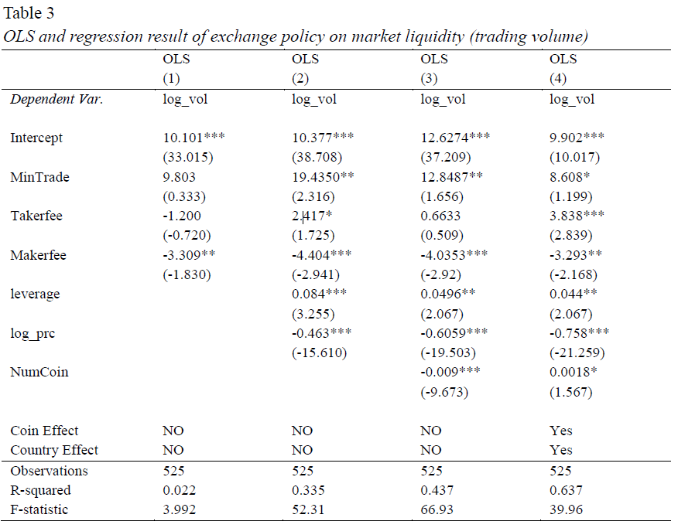
Result

Slide 7
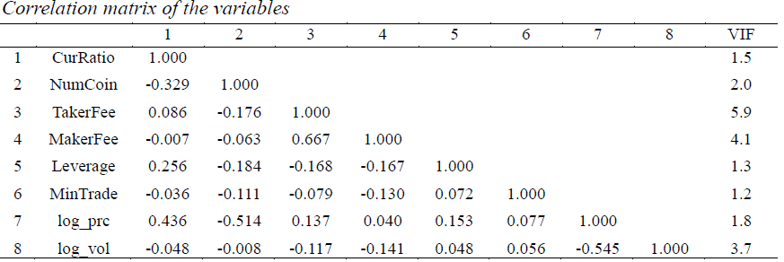
Result
Multicollinearity
The largest correlation coefficient is 0.67 between MakerFee and TakerFee
Theoretically, the two fees affect different impact to the market
All the variables have VIF number less than 10
Notes:
which infers that a multicollinearity issues in this analysis is less likely.

Slide 8
Result
RQ1: Trading fee
Each additional percentage increases in taker fee and maker fee affect the trading volume with the size of 3.83% and -3.23% (significant level of 0.05)
RQ2: Margin trading
examined the effect of the level of leverage used in margin trading
For every unit increase in Leverage, the trading volume increased by 4.4% with the confidence level of 95%.
Notes:
As the maker fee increased, people are likely to use marker order to trade their shares rather than stacking their orders on the orderbook because of the trading promptitude.
In the case of the taker fee, people are less like to submit their order as a market order because of its high fee. In this manner, as the maker fee decreases and taker fee increases, liquidity of the market increases.
The more the leverage is available, the trading volume as liquidity proxy increased

Slide 9
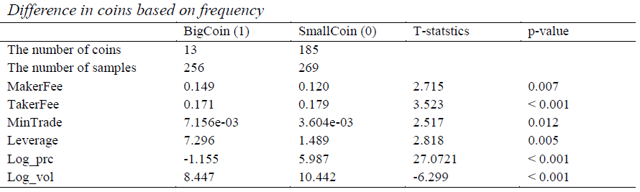
Result
RQ3: Price
The effect of coin price on the trading volume is the 1% increase of price result in 0.61% decrease of trading volume
Additional result
We classified the coins into two group based on the aggregated number of coins traded
All average value of the factors used in this regression analysis are statistically different
Notes:
The Bitcoin is can be traded at the all of the exchanges whereas the Litecoin can be traded at the 28 exchanges.
We create a new dummy variable if more than 5 exchanges dealt with the coin then we labeled 1, otherwise 0.
It refers that the characteristics of coin itself should be controlled.

Slide 10
Conclusion
We examine
The effect of exchange policy and rule of trade on market liquidity(trading volume)
This research reveals that
as the taker fee increased and maker fee decreased trading volume increased
availability of margin trade also statistically affect the trading volume with positive direction
This finding can be adopted to the exchange policies and its regulation.

Slide 11
Thank You

